Slide 1
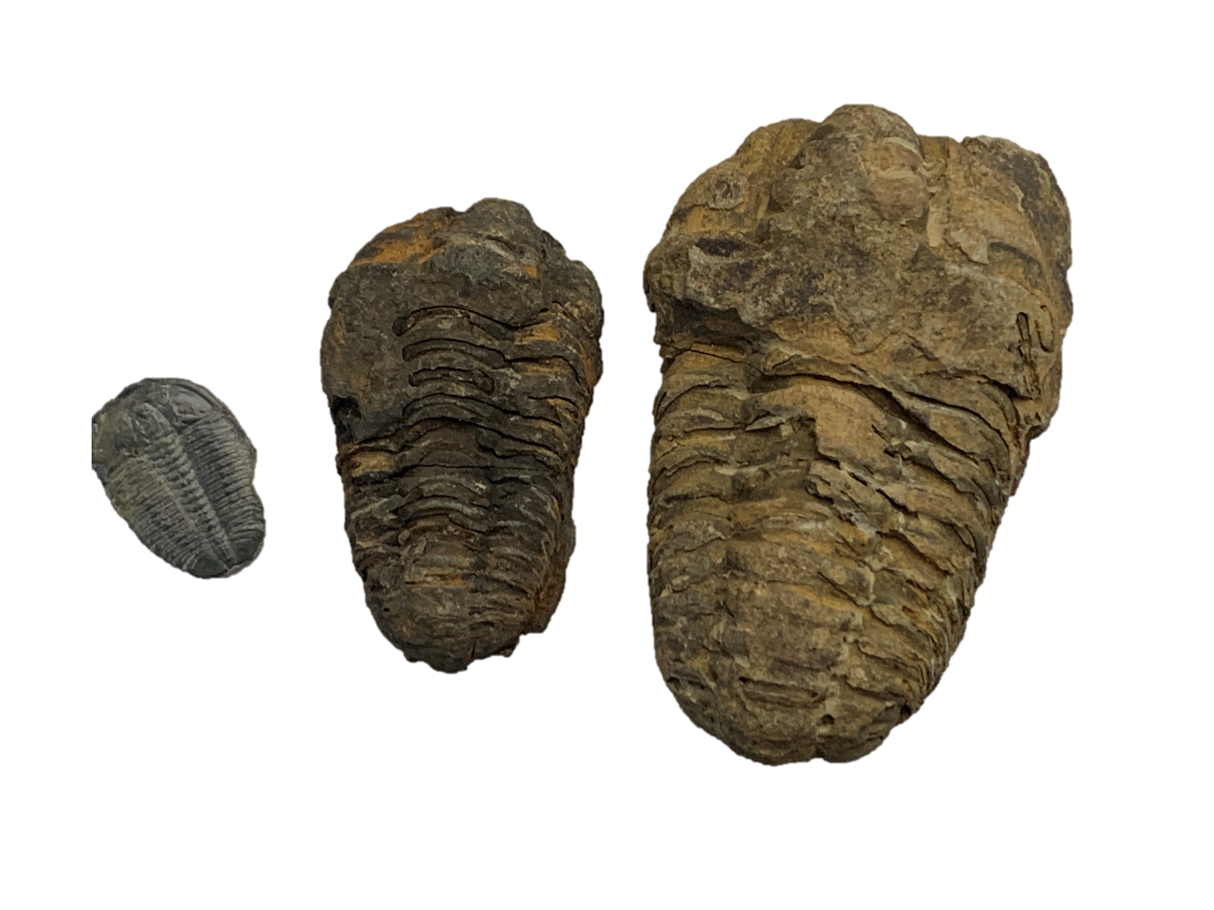
Parallelism & Heterogeneity
Why do we need to care?
GPU
mem
GPU
mem
CPU
CPU
GPU
mem
AI
CPU
CPU
GPU
AI
mem
James Reinders (Intel)
mem

Slide 2
Computer trends: Parallel and Heterogeneous
Our quest for more performance is eternal; how we obtain it adopts to the times.
Once upon a time… a system was a CPU, and we made the CPUs faster and faster over time… 1950s, 1960s, 1970s, 1980s, 1990s, 2000s…
We feared it was unravelling in the mid-1980s, but we were off by two decades.
By 2006, any frequency scaling ended for all intensive purposes.

Slide 3
Computer trends: Parallel and Heterogeneous
Why Parallel?
Desire to get more work done, by having more workers.
Why Heterogeneous?
Desire to get more work done, by having different types of workers.
Workers = compute units, devices, processing units, etc.
(e.g., CPU, GPU, FPGA, ASIC, AI chip)

Slide 4
Computer trends: Parallel and Heterogeneous
Why Parallel?
Desire to get more work done, by having more workers.
Why Heterogeneous?
Desire to get more work done, by having different types of workers.
Workers = compute units, devices, processing units, etc.
(e.g., CPU, GPU, FPGA, ASIC, AI chip)

Slide 5
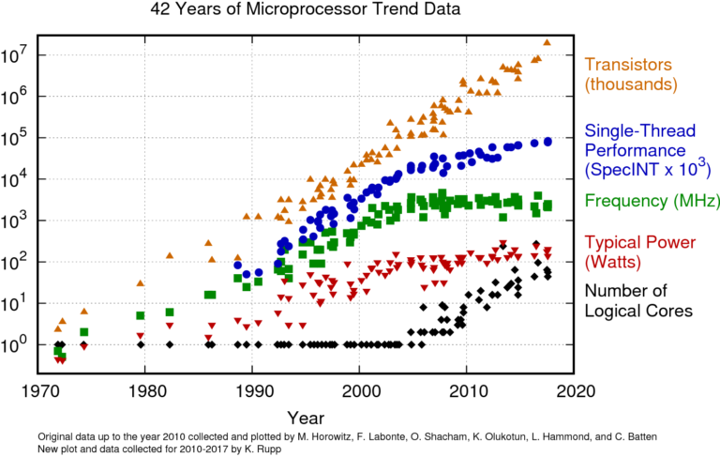
Our quest for more performance is eternal; how we obtain it adopts to the times
Source: tinyurl.com/karlruppdata (CC BY 4.0 license)

Slide 6
Our quest for more performance is eternal; how we obtain it adopts to the times
Source: tinyurl.com/karlruppdata (CC BY 4.0 license)

Slide 7
Our quest for more performance is eternal; how we obtain it adopts to the times
The famous
“Hit the Power Wall”
~2006

Slide 8
Our quest for more performance is eternal; how we obtain it adopts to the times
The famous
“Hit the Power Wall”
~2006
Why?
Performance stopped scaling with frequency enough to justify the power increases.
Before 2006: Double Perf = Double Performance; that used to be OKAY
(actual math: Double Frequency, Quadrupled Power – but Shrink in Half to Halve the Power)

Slide 9
Our quest for more performance is eternal; how we obtain it adopts to the times
The famous
“Hit the Power Wall”
~2006
Why?
Performance stopped scaling with frequency enough to justify the power increases.
Before 2006: Double Perf = Double Performance; that used to be OKAY
(actual math: Double Frequency, Quadrupled Power – but Shrink in Half to Halve the Power)
Around 2006 – Three problems converged:
Power Wall: Thermal Constraints meant performance Increases no longer allowed to scale up power needs
Memory Wall: Frequency scaling of computation not scaling system performance, largely due to memory
ILP Wall: Not enough single-threaded parallelism to fuel performance gains.

Slide 10
Our quest for more performance is eternal; how we obtain it adopts to the times
The famous
“Hit the Power Wall”
~2006
Why?
Performance stopped scaling with frequency enough to justify the power increases.
Before 2006: Double Perf = Double Performance; that used to be OKAY
(actual math: Double Frequency, Quadrupled Power – but Shrink in Half to Halve the Power)
Frequency flattens, power consumption flattens.
The age of frequency scaling ends.
Around 2006 – Three problems converged:
Power Wall: Thermal Constraints meant performance Increases no longer allowed to scale up power needs
Memory Wall: Frequency scaling of computation not scaling system performance, largely due to memory
ILP Wall: Not enough single-threaded parallelism to fuel performance gains.

Slide 11
Our quest for more performance is eternal; how we obtain it adopts to the times
The famous
“Hit the Power Wall”
~2006
While this flattens…
…parallelism rises…
…because our quest for more performance never ends.

Slide 12
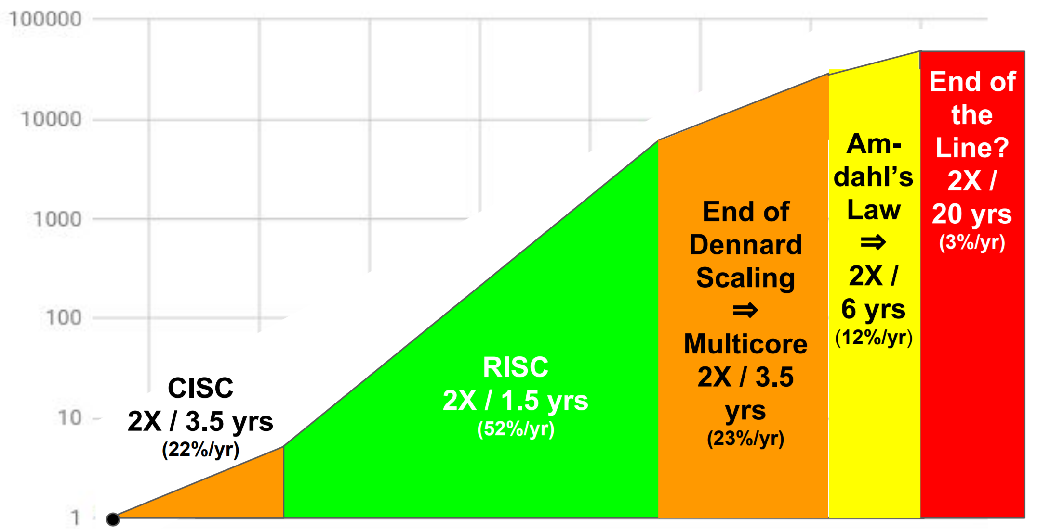
End of speed-ups, unless we go parallel ?
100,000
10,000
1,000
Performance vs. VAX11-1780
100
10
1
1980
1985
1990
1995
2000
2005
2010
2015
source: https://tinyurl.com/HPcambrian
(ISCA 2018 presentation by John Hennessy and David Patterson)

Slide 13
Parallelism need not be homogeneous
It’s easier sticking with homogeneous, but increasing that is not enough.
Remember our insatiable appetite for performance?

Slide 14
Architectures that “go parallel” are limited only by our imaginations (and various tolerances)
SIMD on processors (e.g., MMX, SSE, AVX, DL-Boost, …)
GPU – on and off die/package
FPGA
ASIC (e.g., TPU, many AI start-up chips)
Why specialize?
More effective parallelism for a specific domain – *MD/*MT/VLIW/OoO/Pipelines
More effective use of memory bandwidth – less hardware managed caches
Eliminate unnecessary accuracy – increase performance by reducing pressures
Eliminate unnecessary generality – rely on more limited languages/frameworks

Slide 15
Architectures that “go parallel” are limited only by our imaginations (and various tolerances)
SIMD on processors (e.g., MMX, SSE, AVX, DL-Boost, …)
GPU – on and off die/package
FPGA
ASIC (e.g., TPU, many AI start-up chips)
Why specialize?
More effective parallelism for a specific domain – *MD/*MT/VLIW/OoO/Pipelines
More effective use of memory bandwidth – less hardware managed caches
Eliminate unnecessary accuracy – increase performance by reducing pressures
Eliminate unnecessary generality – rely on more limited languages/frameworks

Slide 16
What does a machine look like in a heterogeneous world?
CPU

Slide 17
pet peeves
CPU mean “central” processing unit
every computer has one, or more CPUs, by definition
Maybe a better term is “most central processing unit” since in a heterogeneous world, we will have many
(diverse)processing units
A sort of “who is in charge” (at least at first)
CPU does NOT mean microprocessor
CPU

Slide 18

What does a machine look like in a heterogeneous world?
CPU
Yes!

Slide 19
What does a machine look like in a heterogeneous world?
Key: Each processing unit (PU) can be doing work at the same time (in parallel)
CPU
CPU
GPU
Of course!

Slide 20
What does a machine look like in a heterogeneous world?
CPU
CPU
CPU
Yes!
CPU
GPU
GPU
CPU
Yes!
GPU

Slide 21
What does a machine look like in a heterogeneous world?
CPU
GPU
GPU
CPU
CPU
GPU
Every device can be doing work in parallel.
GPU
GPU
CPU
GPU
GPU
CPU
CPU
GPU
Yes!
CPU
GPU

Slide 22
What does a machine look like in a heterogeneous world?
CPU
FPGA
GPU
CPU
GPU
CPU
Every device can be doing work in parallel.
AI
GPU
CPU
CPU
CPU
AI
GPU
GPU
CPU
Yes!
GPU
GPU
GPU
CPU
GPU
GPU
CPU
GPU
GPU

Slide 23
What does a machine look like in a heterogeneous world?
CPU
FPGA
GPU
CPU
GPU
AI
GPU
CPU
GPU
CPU
GPU
AI
GPU
CPU
CPU
CPU
CPU
GPU
AI
CPU
GPU
FPGA
CPU
GPU
CPU
AI
Yes!
CPU
GPU
GPU
AI
CPU
GPU
GPU
GPU
AI
Every device can be doing work in parallel.
CPU
GPU
GPU
CPU
GPU
GPU
Yes!
GPU
GPU

Slide 24
What does a machine look like in a heterogeneous world?
mem
CPU
mem
FPGA
GPU
CPU
mem
GPU
mem
AI
mem
GPU
mem
CPU
GPU
mem
CPU
GPU
AI
GPU
mem
CPU
mem
CPU
CPU
mem
CPU
GPU
mem
AI
CPU
GPU
mem
mem
CPU
GPU
FPGA
CPU
AI
mem
CPU
GPU
mem
GPU
AI
CPU
GPU
GPU
GPU
mem
AI
mem
Memory adds to the fun.
CPU
mem
GPU
GPU
mem
CPU
GPU
GPU
Oh my!
GPU
GPU
mem

Slide 25
What does a machine look like in a heterogeneous world?
mem
FPGA
GPU
Diversity in devices (capabilities)
Diversity in memory connectivity/coherence
Diversity in how they all connect
Desire to use them all concurrently in parallel
This is the world we need to support.
We’ll learn how SYCL helps with all these.
mem
CPU
CPU
mem
GPU
mem
AI
mem
GPU
mem
CPU
GPU
mem
CPU
GPU
AI
GPU
mem
CPU
mem
CPU
CPU
mem
CPU
GPU
mem
AI
CPU
GPU
mem
mem
CPU
GPU
FPGA
CPU
AI
mem
CPU
GPU
mem
GPU
AI
CPU
GPU
GPU
GPU
mem
AI
mem
CPU
mem
Memory adds to the fun.
GPU
GPU
mem
CPU
GPU
GPU
GPU
GPU
mem

Slide 26
Architectures that “go parallel” are limited only by our imaginations (and various tolerances)
SIMD on processors (e.g., MMX, SSE, AVX, DL-Boost, …)
GPU – on and off die/package
FPGA
ASIC (e.g., TPU, many AI start-up chips)
Why specialize?
More effective parallelism for a specific domain – *MD/*MT/VLIW/OoO/Pipelines
More effective use of memory bandwidth – less hardware managed caches
Eliminate unnecessary accuracy – increase performance by reducing pressures
Eliminate unnecessary generality – rely on more limited languages/frameworks

Slide 27

A New Golden Age for Computer Architecture
“The next decade will see a Cambrian explosion of novel computer
architectures, meaning exciting times for computer architects in
academia and industry.”
ACM Turing Award laureates John Hennessy and David Patterson (CACM, Feb 2019, Vol 62, No 2, pp 48-60)
recommend: https://tinyurl.com/HPcambrian
Notes:
Photos of Cambrian Fossils (trilobites) by James Reinders, of his own fossils, and are presented here without any copyright claims of any sort – pure and simple public domain photo. - James Reinders, October 27, 2021
Wikipedia says: The Cambrian explosion or Cambrian radiation was an event approximately 541 million years ago in the Cambrian period when practically all major animal phyla started appearing in the fossil record. It lasted for about 13 – 25 million years and resulted in the divergence of most modern metazoan phyla.
Before the Cambrian explosion, most organisms were relatively simple, composed of individual cells, or small multicellular organisms, occasionally organized into colonies. As the rate of diversification subsequently accelerated, the variety of life became much more complex, and began to resemble that of today. Almost all present-day animal phyla appeared during this period.
The first discovered Cambrian fossils were trilobites.

Slide 28
Can we survive the diversity? Do we have a choice?
To survive, we need “open, multivendor, multiarchitecture”
Why?
When a computer was homogeneous – we could program it with any tool, even if it was unique or proprietary.
When a computer is heterogeneous – we need tools to work together.
If they don’t – will we be forced to use only single vendor machines?
Getting tools to work together is hard – and incomplete today.
The Cambrian explosion

Slide 29
Before we use SYCL, we need to
Think Parallel

